Slide 1
How to Manage Stress in Case Management Storyboard
By: Lauren Stalford
About this Training:
Audience: New Case Managers
Desired Learner Status: 100% of new employees can identify causes of case management stress and implement a stress management plan on the job.
Targeted Learning Theory: Knowles’ 4 Principles of Adult Learning (Slade, 2020):
Autonomy
Action/Reflection
Problem-Based Learning
Relevancy

Slide 2
Learning Objectives of Training
Terminal Objective: After completing the How to Manage Stress in Case Management eLearning Module, case managers will be able to use stress management techniques accurately in the school environment.
Main Objective 1.0 Given case-based examples and practice videos, plan how to use common stress management techniques in a school context, so that stress management techniques are accurately matched to their potential stressor and the plan is compatible with a school environment.
Subordinate Objective1.1 Given new employee onboarding training and case-based scenarios, identify common stressors of case managers in public schools, so that all common stressors are accurately identified in case-based context.
Subordinate Objective 1.2 Given case-based scenario examples, identify common stress management techniques so that all stress management techniques are accurately identified when shown.
Subordinate Objective 1.3 Given case examples and stress management techniques video, practice stress management techniques, so that all five common techniques have been accurately completed.

Slide 3
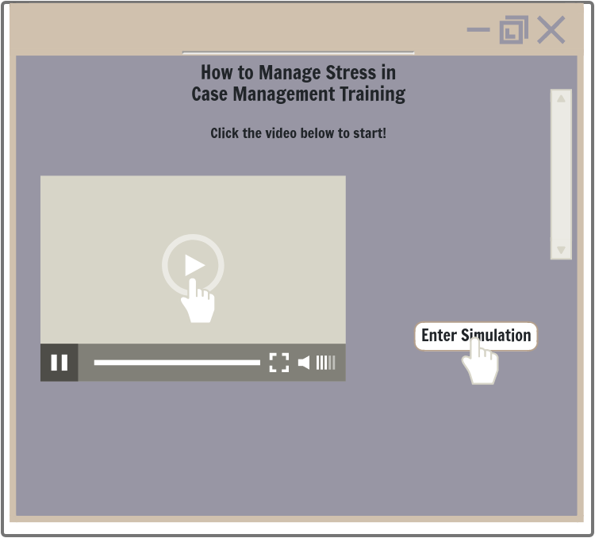
Lesson Title: How to Manage Stress in Case Management
Slide ID: Home Page
Learning Objective Targeted: Terminal Objective
Home Screen:
-Introduction to the Course Video with a play button
-Enter Simulation button moves learners to next page
Visual:
Programming/Interactions
Reviewer Comments
Audio:[Video Narration] Welcome to the How to Manage Stress in Case Management Training. This training is designed to provide insights into common stressors of case management in a public school setting. New case managers report feeling unprepared for environmental stressors of the case management role. Together, we will walk through common stress scenarios in the public schools and plan ideas for how to combat these common stressors. Before we get started, a quick disclaimer: The information in this training is for informational purposes only. This training is not intended to be a substitute for professional advice, diagnosis or treatment. Always seek the advice of a mental health professional or other qualified health provider with any questions you may have. Never disregard professional advice or delay seeking it because of something you have read in this training. If you are struggling with suicidal thoughts, tendencies or other mental health needs, please contact a health care provider immediately. [Audio continued in notes section]
Visual Notes:[Presentation Slide] Home Page is simple with the title of the training, text directions, an introduction video and the option to enter the. The video will be a case manager welcoming learners to the training and presenting the narration. The case managers will be sitting at a desk and the tone of the video is to be welcoming and conversational. The video will include a disclaimer of the content, instructions to enter the simulation, and a reminder to complete the training in one sitting.
Engagement: Knowles’ Principle of Relevancy: The introduction video focuses on why this topic is relevant to the learners. It helps the case managers link the topic of stress management to their work on school campuses and with students. This is presented at the beginning to help learners see the relevancy before they are presented content.
Notes:
[Audio continued] Through completing this training, you will have simple tools to work more effectively with students, school staff and administrators, which can lead to more satisfaction in your new role. We will start by walking through case management simulations where you will help case managers make choices about how to handle stressors in their day to day life. The scenarios a meant to be interactive. We want you to listen to the case and put yourself in the case managers shoes—how would you feel? What would help you in this situation? As you go through the scenarios, you will be asked to make choices and you will be given feedback. This feedback is not to “grade” your responses, but to help guide you through the situation and start thinking like a case manger. If you need help during the simulations, look for the clipboard icon in bottom left of the screen. This will pull up a stress management guide that may help provide additional information as you make choices in the training. You will be able to access this guide at any point you are being asked to make decisions. After the simulation scenarios, you will create your own personal stress management action plan. Be thinking about what stressors and stress management techniques are standing out to you personally along the way! Please be aware, the training is designed to be completed in one sitting. The full training takes an average of 20 minutes to complete. Please do not start the training until you have time to complete it.

Slide 4
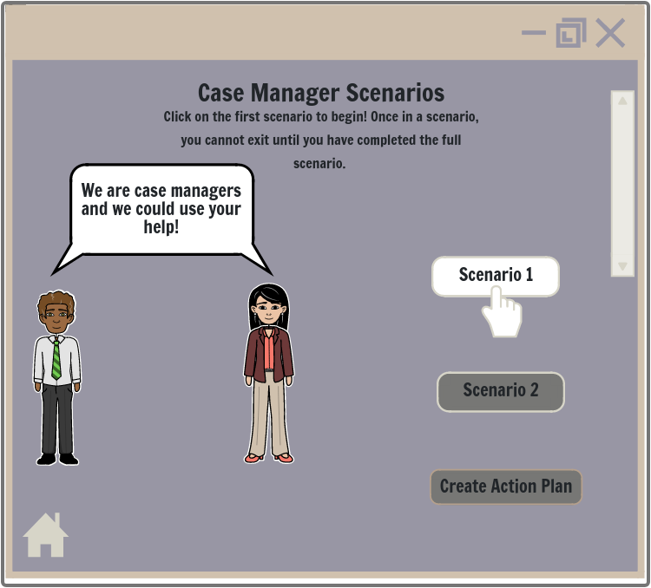
Lesson Title: How to Manage Stress in Case Management
Slide ID: Scenarios Home Page
Targeted Learning Objective: Terminal Objective
Case Scenarios Main Page:
-Scenario 1 Button (in color and clickable)
-Scenario 2 Button (greyed out)
-Action Plan Button (greyed out)
-Home Page Icon clickable to return learners to Home Page Screen
Visual:
Programming/Interactions
Reviewer Comments
Audio: N/A
Visual Notes: [Text-Based Slide]: Slide shows a visual of the two scenario case managers prompting the learners for help. Text on screen will instruct learners to click on the scenarios to begin.
Engagement: Knowles’ Principles of Autonomy and Problem-Solving: The Scenarios introduce learning through problem-solving rather than learning through presentation of content. This is done to give the learners’ choices in their learning and guide learning as learners engage in solving relevant problems.

Slide 5
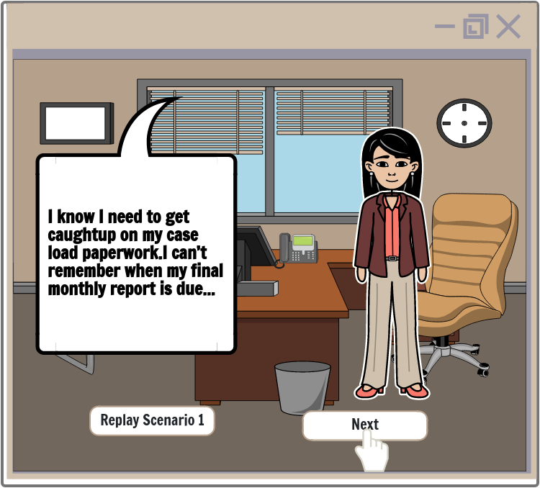
Slide ID: Scenario 1: Scene: 1.1
Targeted Learning Objective: Subordinate Objective 1.1
Lesson Title: How to Manage Stress in Case Management
Scenario 1:
-Scenario will automatically play for learners
-Next Button clickable after scenario plays
-Replay Button clickable after scenario plays
Visual:
Programming/Interactions
Reviewer Comments
Audio:[Case Manager] I know I need to get caught up on my case load paperwork. I can’t remember when my final monthly report is due, but I know I should work on my student reports today. [Email comes through] Seems like there is an issue with a student in their English class. The teacher wants to talk during his advisory time. I think I can fit that in if I skip my normal lunch break.
[Phone ring sound] [Counselor] Hi Emilia, we are having a student emergency here in the counseling office. Can you tell us if Ron Schwartz is on your case load? If not, we would like you to contact the parents about getting him into your program.
[Emilia]Right, Ron is on our case load. We’ve been working with him for two months.
[Counselor]Oh-that’s good to hear. That makes everything easier. Can you come to our offices? He is expressing suicidal feelings and we want to run a suicide check on him. It would be so helpful if you could come be a part of this meeting.
[Audio continues in Notes Section of the slide]
Visual Notes: [Presentation Slide]: Learners will watch the first animated scenario. A case manager is in her office attempting to complete paperwork. The office set up should look simple and realistic with items such as a desk, chairs, computer, and phone. Case manager is dressed professionally in slacks and a professional blouse. The scene will run with dialogue and text on the screen. The case manager should look clearly upset and overwhelmed by the end of the day. After scene plays replay and next button options appear.
Engagement: Knowles’ Principle of Problem-Solving: Learners are immersed in a case manager’s day and watch as growing problems occur. This is to present content in a way that focuses on problem-solving.
Notes:
[Audio Continued]:
[Back in office] That meeting took hours, but it was so important to be there. At least Ron’s father was able to come and be a part of the meeting. I’ve got to go talk with the English teacher—he seemed pretty upset and I can’t cancel so last minute. The counselors asked me to sit in on a parent teacher conference for a new student not yet in the program. We are trying to build our case load, so I couldn’t say no.
[3 hours later] Ok, the meeting went well. One of the councilors wanted to talk about my program ideas for this year, so that took longer than expected. I have half an hour left—I think I’ll start on the paper work.
[Email alert from supervisor]: Hi Emilia, your monthly report was due at noon today. When can you have it to me by?”

Slide 6
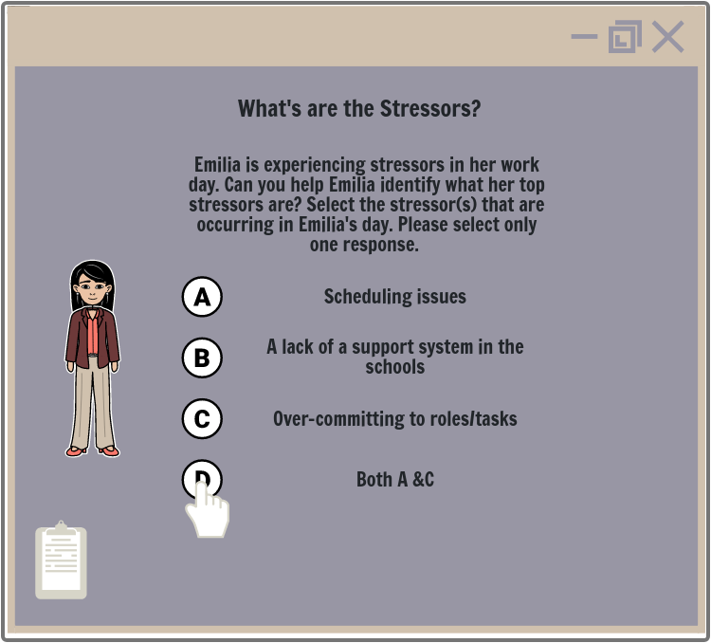
Lesson Title: How to Manage Stress in Case Management
ID Slide: Scenario 1: Scene: 1.2
Targeted Learning Objectives: Subordinate Objective 1.1
Knowledge Check 1:
-Question box will appear on the screen with multiple choice options.
-Learners will click on an answer.
-Clipboard Icon clickable to pull up Case Management Sheet
Branching Options:
-Feedback 1 text box will appear for correct answer (Answer D).
-Feedback 2 text box for incorrect answer (Answers A, B, and C).
Visual:
Programming/Interactions
Reviewer Comments
Audio: [Plays Automatically] Given the scenario you just watched, think about the situations that added stress to Emilia’s day. What type(s) of stressors are occurring in Emilia’s work day?
Visual Notes: [Decision-Based Slide]: A question box will appear on the screen with audio prompting learners to select a type of stressor. Audio should play automatically to guide the learner. A visual of the case manager should be on the screen to continue to engage the learner in the scenario. Clipboard icon available in lower-left side of screen.
Engagement: Knowles’ Principle of Autonomy: Learners are interacting with the scenario and get to make choices regarding which stressors they feel are occurring. This format was chosen to give learners choice during their learning time and to give learners control of their learning.

Slide 7
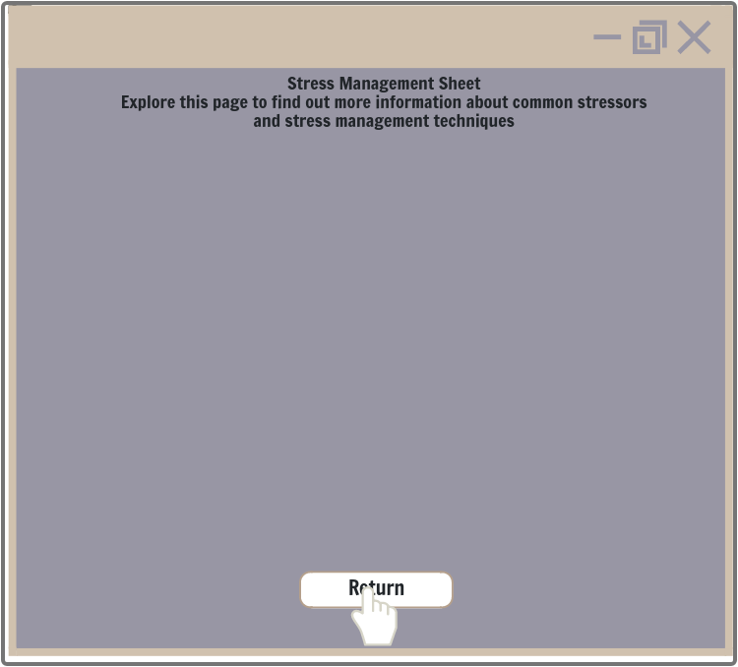
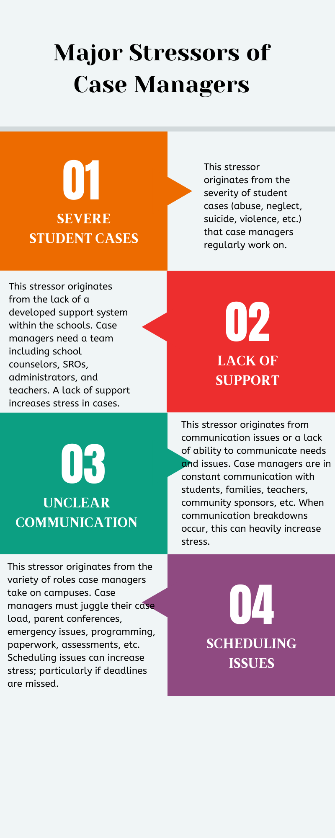
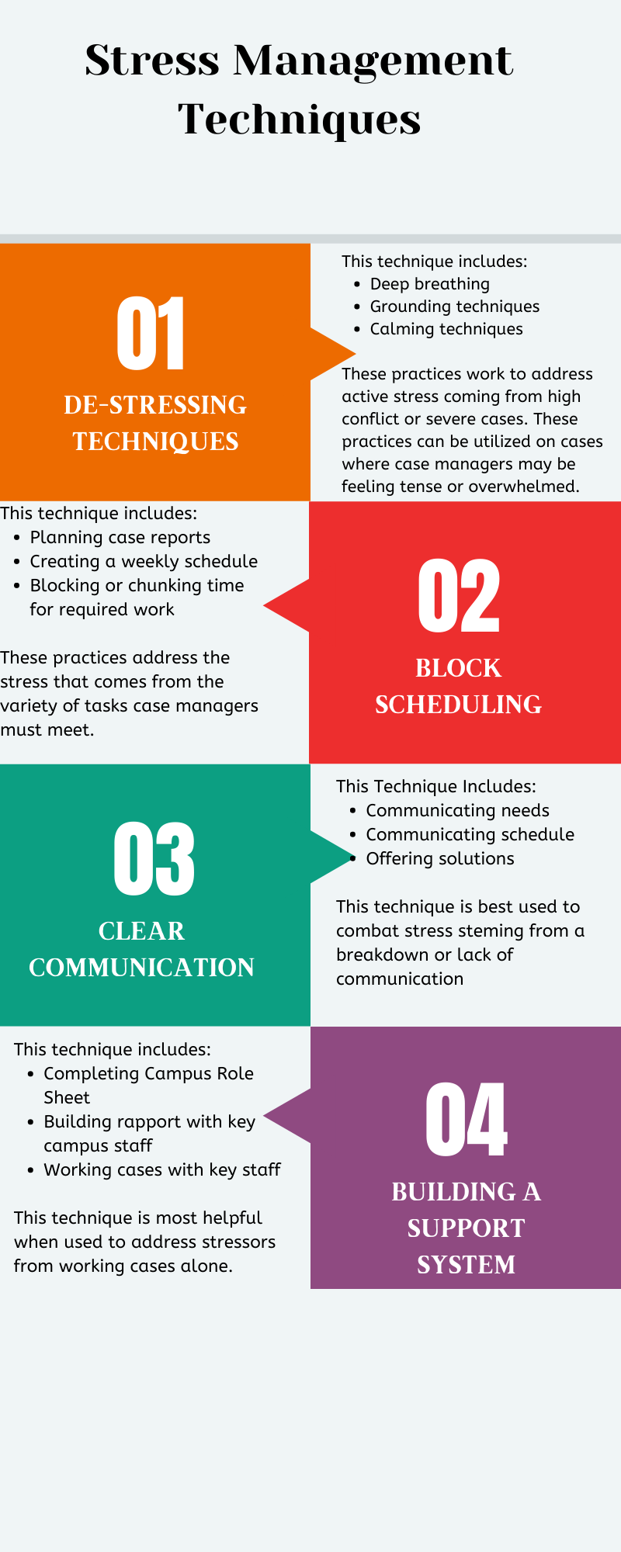
Lesson Title: How to Manage Stress in Case Management
ID Slide: Scenario 1: Scene: 1.2.1
Targeted Learning Objectives: Terminal Objective
Case Management Sheet
-Sheet pulls up when the Clipboard Icon is clicked.
-Learner can read through information
-Return Button takes learners back to page they were on.
Visual:
Programming/Interactions
Reviewer Comments
Audio: N/A
Visual Notes: [Text-Based Slide]: Case Management Sheet will be simple with a title and definition of each common stressor and a title and definition of each stress management technique. Learners can access this sheet during all knowledge checks and the final assessment. A larger display of the Stress Management Sheet visuals can be seen in the Appendix Section of the Storyboard.
Engagement: Knowles’ Principle of Problem-Solving: The sheet will provide relevant information to aid learners in solving the scenario problems.

Slide 8
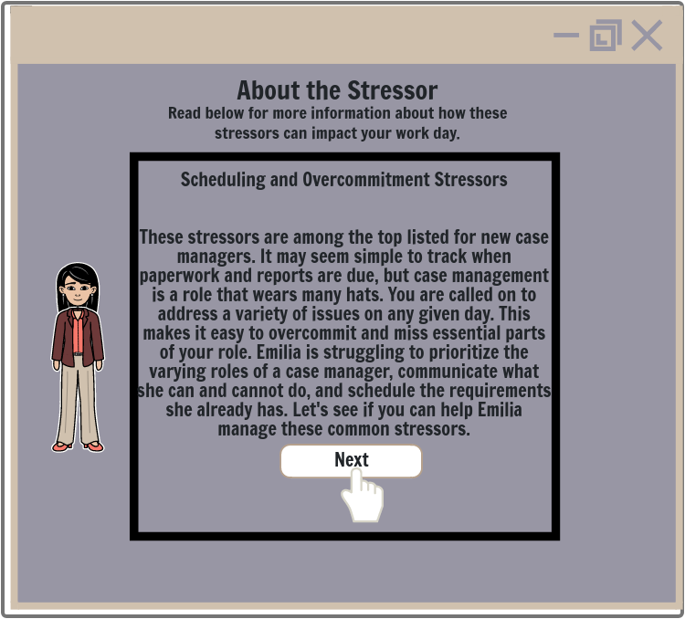
Lesson Title: How to Manage Stress in Case Management
ID Slide: Scenario 1: Scene: 1.2.2
Targeted Learning Objective: Subordinate Objective 1.1
Feedback 1 Branch:
-Feedback 1 Text Box will appear for correct answer.
-Next button will move learners to next screen.
Visual:
Programming/Interactions
Reviewer Comments
[Audio] [Feedback One Response][Plays automatically]: Great thinking! Emilia is struggling with scheduling her case load and with overcommitting in her role as a case manager. While an emergency occurred with one of her students, Ron, that had to be responded to, Emilia also committed to spending most of her day in unplanned meetings with teachers, new students, and the counselors. These meetings and needs could be scheduled for other days, or met in other ways. Read below for more information about this type of stressor.
Visual Notes: [Text-Based Slide]: Audio Plays automatically when learners are on this screen. A text box appears with details about this type of stressor. Learners click the next button after viewing the information in the text box. Image of case manager appears beside the text box.
Engagement: Knowles’ Principle of Relevancy: This is a content-heavy section of the training; however, it is designed to provide practical and relevant information about case managers’ roles and the public school environment to keep learners engaged.

Slide 9
Lesson Title: How to Manage Stress in Case Management
ID Slide: Scenario 1: Scene: 1.2.3
Targeted Learning Objective: Subordinate Objective 1.1
Feedback 2 Branch:
-Feedback 2 Text Box will appear for incorrect answers.
-Clipboard Icon clickable to pull up Case Management Sheet
-Return Button will return learners back to the question.
Visual:
Programming/Interactions
Reviewer Comments
[Audio] [Feedback Two Response] [Plays automatically]: That is a common stressor on school campuses, but let’s consider some facts about the scenario. Emilia has a lot on her plate today. She had a deadline that she did not realize or schedule into her day, and she was pulled into many last minute meetings. She is taking on a lot of commitments in her role as a case manager AND not considering what her schedule will allow. What type of stressor or stressors best describes these issues?
Visual Notes: [Text-Based Slide]: An incorrect answer will provide dialogue to prompt the learner to re-consider their response. Learners will click the return button to go back to the question box. An image of the case manager Emilia should be next to the text box. The case manager should look confused. Clipboard icon for the Case Management Sheet should appear in the bottom left corner of the screen.
Engagement: Knowles’ Principle of Problem-Solving: The feedback is designed to prompt the learner to reconsider their response with some additional guidance. Rather than focusing on if learners are correct or incorrect, the feedback is designed to keep working with the learner and help them to solve the scenario problem.

Slide 10
Slide ID: Scenario 1 Scene: 1.3
Targeted Learning Objective: Objective 1.3
Lesson Title: How to Manage Stress in Case Management
Feedback 1 Branch:
-Feedback 1 is automatically provided when learners select the correct response.
-Learners will click to view the video presentation
-Next Button will move learners to next screen
Visual:
Programming/Interactions
Reviewer Comments
Audio: [Video Voiceover]: Block scheduling and clear communication are two simple ways to ensure case management requirements and high priority cases are met. After a year on the job, many case managers report feeling like they are spending their whole work day “putting out fires” rather than purposefully completing tasks. This can be detrimental to the assessment needs of students and to the satisfaction of case managers’ jobs. School campuses are hectic fast-paced environments. There will always be phone calls and emails with new situations that compete for your time. One simple way to combat this is to block out times with required case load work. This work could be meeting with students or completing required paperwork and reports. Block the time out each week at the beginning of the week. Set these blocks as meetings on your calendar. Many case managers find it beneficial to block off the first two hours or the last two hours of the work day for blocks of case load work time as there tend to be less commitments or emergencies during these times of day. [Audio continues in notes section of the slide]
Visual Notes:[Presentation Slide]: Video will play with dialogue over images that show the technique of blocking out time on a calendar schedule and show communicating with staff members. This video shows demonstrations of the techniques while providing information about the techniques.
Engagement: Knowles’ Principle of Relevancy: The content presented in the video is meant to be practical and show how to use the technique in a relevant way. The goal is to link the content to the case managers’ work context.
Notes:
[Audio Continued]
If you are asked to join a last minute meeting/event explain that you already have a scheduled meeting. Emergency events will always occur on school campuses and must be attended. However, other last minute meetings are not a priority. If you feel uncomfortable saying “no” to low priority meetings consider the following techniques. One, keep it simple. Two, give a clear reason you cannot be involved in the current meeting. Clearly explaining that you have to meet with a a student or a deadline to meet. Three, offer up an alternative time to meet. Perhaps you can email about the meeting or maybe you can come by an office after school to discuss the need or issue. Clearly communicating your schedule with teachers, counselors, and other staff can help to ensure campus needs are being met. How do you feel about using these techniques? Can you see yourself setting a clear schedule and communicating your needs to key staff members on campus?

Slide 11
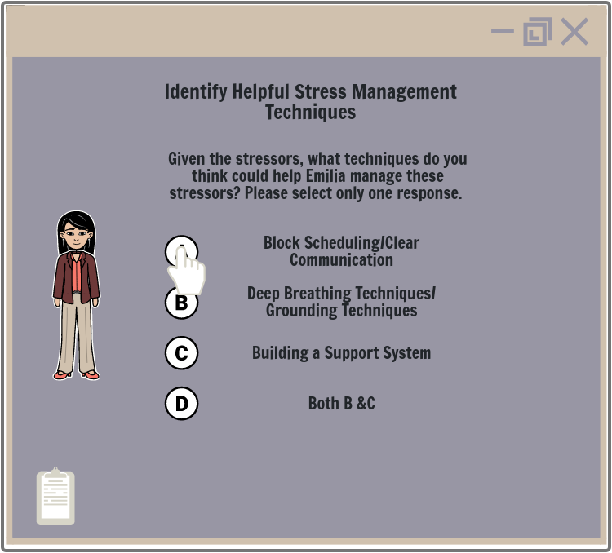
Slide ID: Scenario 1 Scene: 1.3.1
Targeted Learning Objective: Subordinate Objective 1.2
Lesson Title: How to Manage Stress in Case Management
Knowledge Check 2:
-Learners will be prompted with a question and multiple-choice options.
-Learners will select an answer.
-Clipboard Icon clickable to pull up Case Management Sheet
Branching Options:
-Feedback 1 will be given for correct answer.
-Feedback 2 will be given for incorrect answer.
Visual:
Programming/Interactions
Reviewer Comments
Audio:[Plays Automatically] Great job! Both scheduling and over-committing are top stressors that new case managers report on campuses. Case managers are asked to juggle many roles and responsibilities throughout their day, including emergency situations that cannot be planned and must be addressed. Given these stressors, which of the following options would best help Emilia fix the stressor of work scheduling and clear communication issues? Don’t forget to check out the Stress Management Guide for additional support!
Visual Notes: [Decision-Based Slide]: Learners will be presented with a question box. They will click a response and receive feedback depending on the response selected. When learners have selected the correct response, they will be prompted to move to the next screen. Clipboard Icon of Stress Management Sheet is in bottom left of the screen.
Engagement: Knowles’ Principle of Autonomy and Problem-Solving: Learners are given choice in this question and asked to consider how to solve the given stressor problem. This focuses on having learners learn through engaging with a problem rather than learn through content presentation.

Slide 12
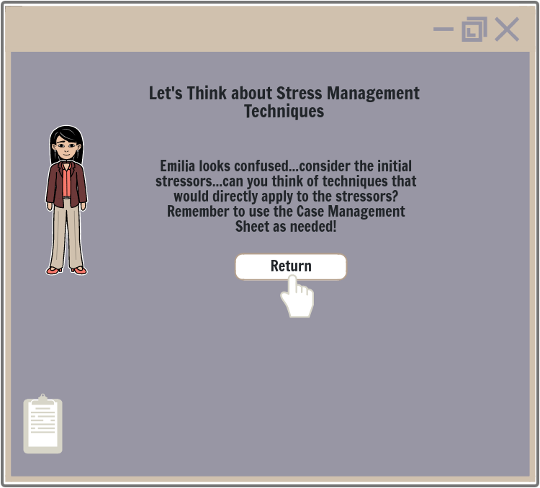
Slide ID: Scenario 1 Scene: 1.3.2
Targeted Learning Objective: Subordinate Objective 1.2
Lesson Title: How to Manage Stress in Case Management
Feedback 2 Branch:
-Feedback 2 will be given for incorrect answer.
-Clipboard Icon clickable to pull up Case Management Sheet
-Return Button will bring learners back to the question box
Visual:
Programming/Interactions
Reviewer Comments
Audio: [Feedback Two] [Plays Automatically]: That is an important stress management technique, but let’s consider the initial stressor. Emilia is struggling with both balancing her schedule and the varying types of commitments in her role. Her tasks are not planned and she is taking every unscheduled meeting she is invited to. This is backing up her work day and causing her to miss deadlines. What types of stress management techniques could specifically address these issues?
Visual Notes: [Text-Based Slide]: Audio will play automatically when an incorrect response is selected. Text prompt will be simple to encourage learners to reconsider their response. Image of case manager will appear next to the text. Case manager should look confused. Return button will be presented under the text for learners to click. Clipboard icon appears in bottom-left of screen for learners to access Case Management Sheet.
Engagement: Knowles’ Principle of Problem-Solving: Learners will be given feedback to help guide the learners as they work through the scenario. Rather than focusing on if learners are correct or incorrect, the feedback is designed to keep working with the learner and help them to solve the scenario problem.

Slide 13
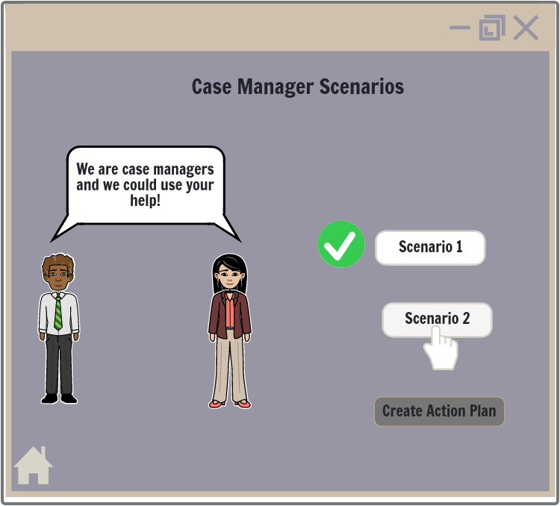
Lesson Title: How to Manage Stress in Case Management
Targeted Learning Objective: Terminal Objective
Slide ID: Scenarios Home Page 1.1
Case Scenarios Main Page:
-Scenario 1 Button (with check mark next to it)
-Scenario 2 Button (in color and clickable)
-Action Plan Button (greyed out)
-Home Page Icon clickable to return learners to Home Page Screen
Visual:
Programming/Interactions
Reviewer Comments
Audio: N/A
Visual Notes: [Text-Based Slide]: Learners will return to this page upon completing Scenario 1. There will be a check mark next to the Scenario 1 Button. Scenario 2 will now be in color and clickable. The Action Plan Button will still be greyed out. Home Page Icon in lower left side of screen.
Engagement: Knowles’ Principles of Autonomy and Problem-Solving: The Scenarios introduce learning through problem-solving rather than learning through presentation of content. This is done to give the learners’ choices in their learning and guide learning as learners engage in solving relevant problems.

Slide 14
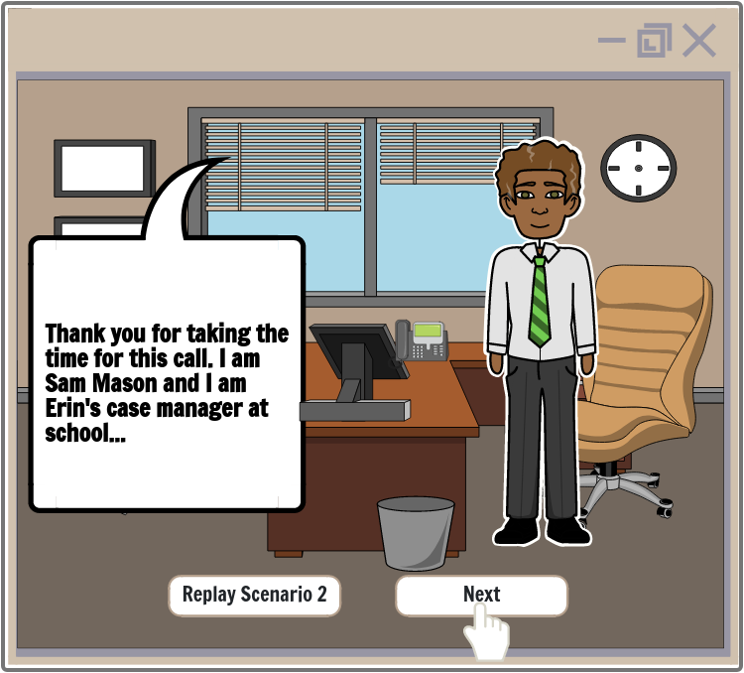
Lesson Title: How to Manage Stress in Case Management
Slide ID: Scenario 2: Scene: 2.1
Targeted Learning Objective: Subordinate Objective 1.1
Scenario 2:
-Scenario #2 will play automatically
-Next Button clickable after scenario plays
-Replay Button clickable after scenario plays
Visual:
Programming/Interactions
Reviewer Comments
Audio:
Case Manager: Thank you for taking the time for this call. I am Sam Mason and I am Erin’s case manager at school. I’ve noted a significant lowering of Samantha’s grades over the past six weeks. We also have notes from some of Samantha's teachers noticing changes in behavior and noted crying and emotional breakdowns in class. I want to start by bringing up our concern with these changes---
Father [interrupts]—Well this her mother’s problem. She’s been staying at her mother’s house for the past month since my work shifts changed. I don’t know what the problem is.
Case Manager: I understand. You were listed as Erin’s primary contact with the school. As I stated, we are noticing some pretty concerning behaviors. Even if Erin hasn’t been at your home recently, maybe you have noticed or heard her mention any new stressors or changes lately?
Father: Uh-I know she doesn’t like her mother’s new boyfriend. She says he fights with her a lot. She wants to spend more time at my house, but like I’ve told her, that’s hard to do with my new shift schedule. Her mother is the one causing this problem and she knows I can’t take Erin back on weekdays.
Case Manager: That sounds like a serious situation. Conflict in her home environment can be stressful at Erin’s age. Do you know the extent to which these fights are occurring? [Audio continues in notes section below]
Visual Notes: [Presentation Slide]: Scenario 2 will be set in the case managers office with similar décor to Scenario 1. The environment should look realistic to a case managers office. Sam is the case manager in this scenario. He should be dressed professionally in slacks and a professional shirt. His tone and look should sound concerned and sad towards the end of the scenario. After scene plays replay and next button options appear.
Engagement: Knowles’ Principle of Problem-Solving: This case is structured to be realistic to the case management role and to clearly show real and common stressors in a case managers job. It presents some issues and is designed for learners to enter into a realistic problem in order to understand and generate solutions.
Notes:
[Audio Continued]
Father: I don’t know—Erin mentions it a lot when we talk. Can’t blame her for not liking the guy. This isn’t the first time there’s been issues with these guys her mother brings home.
Case Manager (Internal Thinking): This doesn’t sound good. I think I’m going to have to pull Erin out of gym and see if I can get her to tell me more about these fights. They could be arguing a lot, but her behavior is indicating more could be going on.
Case Manager: It sounds like there is a lot of conflict at the moment. That can be very stressful for everyone involved. We are able to offer counseling resources since Erin is in our program, maybe we can talk about some options…
Father (interrupting): I can’t pay for that right now and this is her mother’s issue. Her mother starts all of this and now Erin is having problems with school and I can’t do much more than what I have already done.
Case Manager[looks more distressed and concerned]: All of our service are free for students and their families. I have worked with Erin for six months and I feel that Erin could benefit from some additional support given the changes we are seeing. From what you are telling us, it sounds like processing these things with a professional may help.
Father: I don’t know if we need all of that. I can talk with her about the grade issues. I don’t want my daughter talking to a stranger. We can figure this out ourselves and really her mother just needs to fix the problem. Look I have to go, but I’ll get Erin’s grades straightened out.
[Call ends]
Case Manager: Now what? This case feels like a serious one. I need to talk to Erin and see if I can find out more. I hate dealing with these cases on my own. I wish someone else could have been on that call with me. I hope this isn’t turning into another case like I had with Matthew’s family. I don’t know that I can take another case like that.

Slide 15
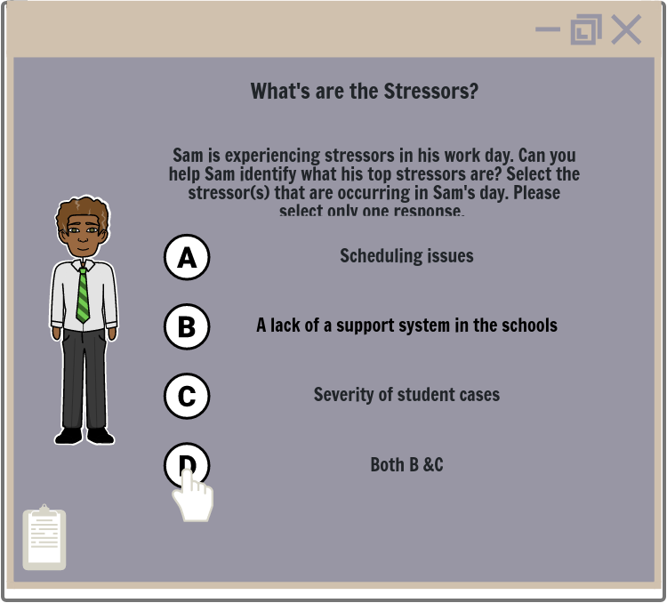
Lesson Title: How to Manage Stress in Case Management
ID Slide: Scenario 2: Scene: 2.2
Targeted Learning Objectives: Subordinate Objective 1.1
Knowledge Check 1:
-Question box will appear on screen.
-Clipboard Icon clickable to pull up Case Management Sheet
-Learners will click on an answer.
Branching Options:
-Feedback 1 text box will appear for correct answer (Answer D).
-Feedback 2 text box for incorrect answer (Answer A, B, and C).
Visual:
Programming/Interactions
Reviewer Comments
Audio: [Plays Automatically]Given the scenario, what type of stressor was occurring in Sam’s work day?
Visual Notes: [Decision-Based Slide]: A question box will appear on the screen with audio prompting learners to select a type of stressor. When learners select an answer, audio and a text box will appear in response to their answer. Image of case manager should appear on screen next to the prompted question.
Engagement: Knowles’ Principle of Autonomy and Problem-Solving: Learners are prompted to make choices at this part of the training and the choices made are to help solve relevant problems within the scenario.

Slide 16
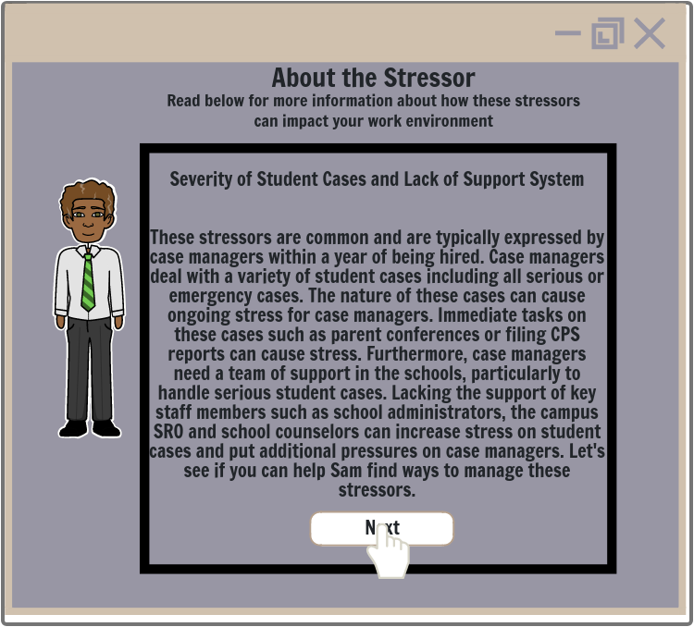
Lesson Title: How to Manage Stress in Case Management
ID Slide: Scenario 2: Scene: 2.2.1
Targeted Learning Objectives: Subordinate Objectives 1.1
Feedback 1 Branch:
-Feedback 1 Text Box will appear for correct answer.
-Next Button clickable when learners are done.
Visual:
Programming/Interactions
Reviewer Comments
Audio:
[Feedback One Response][Plays Automatically]: Good thinking! Sam is facing stressors regarding the severity of his students’ cases and a lack of support within the schools. Read below for more information about these types of stressors. Start to consider how this may impact you on your campus.
Visual Notes: [Text-Based Slide]: The correct answer box will provide more details about the stressor while automated audio plays. Clicking the Next Button will move learners forward in the case scenario. Image of case manager Sam should appear beside the text box. Clipboard icon in bottom-left corner of the screen for learners to access Stress Management Sheet.
Engagement: Knowles’ Principle of Relevancy: The text box provides content information in a way that links the information to case managers and their job context. This is meant to provide content information that can be used and is relevant to the learner.

Slide 17
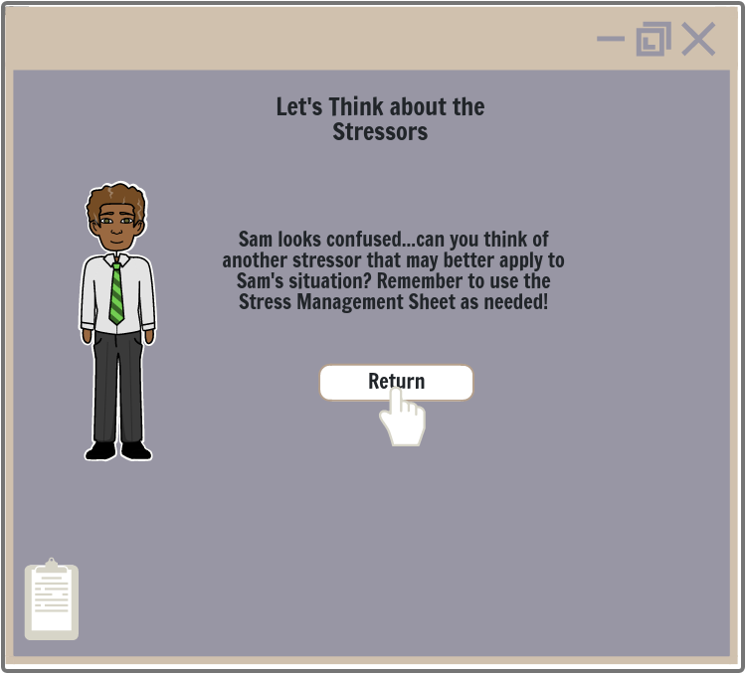
Lesson Title: How to Manage Stress in Case Management
ID Slide: Scenario 2: Scene: 2.2.2
Targeted Learning Objectives: Subordinate 1.1
Feedback 2 Branch:
-Feedback 2 Text Box will appear for incorrect answer.
-Clipboard Icon clickable to pull up Case Management Sheet
-Return Button takes learners back to the Question Box.
Visual:
Programming/Interactions
Reviewer Comments
Audio: [Feedback Two Response][Plays Automatically]: That is a common stressor on school campuses, but let’s consider some facts about the scenario. Sam is in a talking with a parent about serious issues with a student and finding out the extent of the students’ situation. The parent is unresponsive to the severity of the situation. Sam has expressed stress over the severity of the student case and wishing he had other staff members to work on the case with him. What type of stressors best describes these issues?
Visual Notes: [Text-Based Slide]: A question box will appear on the screen with audio prompting learners to select a type of stressor. Image of case manager appears next to the text. Case manager’s facial expression should look confused. Clipboard icon in bottom-left corner of screen.
Engagement: Knowles’ Principle of Problem-Solving: Guidance is provided to assist the learner as they solve relevant problems. This is not to focus on a correct or incorrect answer, but to guide learners as they solve problems.

Slide 18
Lesson Title: How to Manage Stress in Case Management
Targeted Learning Objective: Subordinate Objective 1.3
Slide ID: Scenario 2 Scene: 2.3
Feedback 1 Branch:
Video of Stress Techniques
-Video slide will be presented immediately after correct answer is selected.
-Learners will click to view the video.
-Learners can pause and replay video as desired.
-Next Button moves learners to next screen.
Visual:
Programming/Interactions
Reviewer Comments
Audio:
[Video Voiceover]: Building a support system is critical for case managers on school campuses. Severe cases cannot be handled by the case manager alone. School counselors, the campus SRO, CPS, and school administrators may need be involved depending on the case. While there are ethical and legal reasons for this, this is also a significant way to handle high-stress cases. If Sam had been able to talk with the campus SRO or the school counselors, he may have been able to have a conference meeting or call with Erin’s father, which may have lowered the stress in that conversation. Building a team of support comes down to recognizing who are critical staff members to get to know. You should have an emergency contact sheet filled in so you know who to reach out to and when. This is a simple form that provides the names, emails, numbers and offices of key personnel. Building rapport with these staff members is critical. When you get to campus, make sure to meet each of these persons face-to-face within your first few days. Start by asking them what they think high needs for students are and how they prefer to work with/hear from you. [Audio continues in Notes Section of slide]
Visual Notes:[Presentation Slide]: Video will focus on demonstrating these stress management techniques as voice over narration plays. The video will show the form to fill out, and images of building a support team. It will also show demonstrations of deep breathing and de-stressing techniques while audio plays. These demonstrations will show a case manager using these de-stressing techniques in an office environment.
Engagement: Knowles’ Principle of Relevancy: Content will be presented in a realistic and relevant way to engage the learner. Demonstrations will focus on relevant contexts that can be used in the learners’ work environment.
Notes:
[Audio Continued]
Also, simple de-stressing techniques can help when cases and conversations and meetings are getting difficult. It’s common to be tense in these types of interactions. Deep breathing exercise can help to reduce stress within minutes. Taking a minute to breath can help the current stress levels. Case managers are often running from meeting to meeting without taking a short moment to decompress. If you feel your stress levels rising, take a minute. You can do this in your office in between meetings or if in a meeting, leave to go to the restroom. A temporary break from a high stress conversation can help lower the stress in that immediate moment. It can also help you come back to the meeting more objectively.

Slide 19
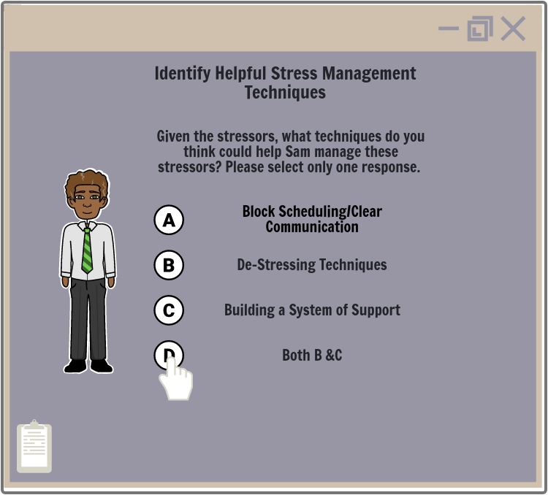
Slide ID: Scenario 1 Scene: 2.3.1
Targeted Learning Objectives: Subordinate Objective 1.2
Lesson Title: How to Manage Stress in Case Management
Knowledge Check 2:
-Learners will be prompted with a question and multiple-choice options.
-Clipboard Icon clickable to pull up Case Management Sheet
-Learners will select an answer.
Branch Option:
-Feedback 1 will be given for correct answer (Answer D).
-Feedback 2 will be given for incorrect answer (Answer A, B, & C).
Visual:
Programming/Interactions
Reviewer Comments
Audio: [Plays Automatically]Great job! Severity of student cases and feeling a lack of support are very common causes of stress for case managers. Severe cases include cases that affect a students’ physical wellbeing and can involve abuse, violence, suicide, etc. These cases are often complex and can be stressful to work on. Over time, many case managers report feeling burnt out due to the severity of student cases. Given the stressors, which of the following stress management techniques would be most helpful to Sam with the stress of this case? Remember to check the Stress Management Sheet for additional support.
Visual Notes: [Decision-Based Slide]: Learners will be presented with a question box. They will click a response and receive feedback depending on the response selected. Image of case manager will be beside the question box. Clipboard icon in the bottom-left of the screen.
Engagement: Knowles’ Principle of Autonomy and Problem Solving: Learners will be asked to make choices within the scenario. This gives learners autonomy in their learning through solving relevant problems.

Slide 20
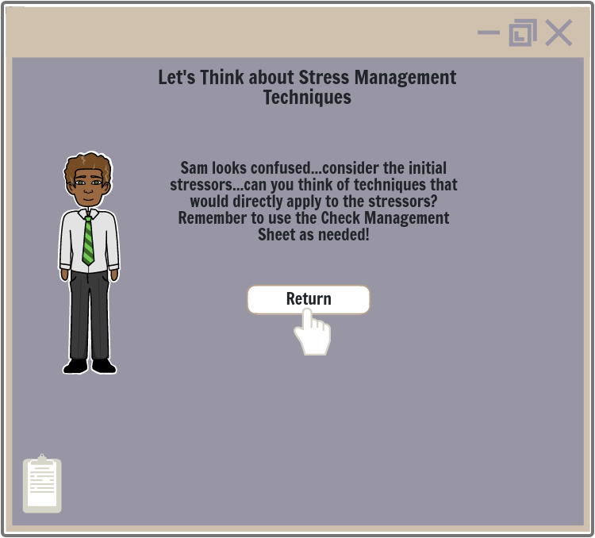
Slide ID: Scenario 1 Scene: 2.3.2
Targeted Learning Objective: Subordinate Objective 1.2
Lesson Title: How to Manage Stress in Case Management
Feedback 2 Branch:
-Feedback 2 will be given for incorrect answers
-Clipboard Icon clickable to pull up Case Management Sheet
-Return Button takes learners back to question box.
Visual:
Programming/Interactions
Reviewer Comments
Audio:[Feedback Two] [Plays Automatically]:That is an important stress management technique, but let’s consider the initial stressor. Sam is facing a serious student case where a parent is unresponsive to help or providing specific details of what is going on with the student. Sam is currently alone in reaching out to the parent. What types of stress management could specifically address these issues?
Visual Notes: [Text-Based Slide]: Learners will be presented with a text box encouraging them to reconsider their answer. A visual of the case manager will appear beside the text. The case manager should have a confused look on his face. A return button will take learners back to the question box. Clipboard icon in bottom-left of screen for learners to access Case Management Sheet.
Engagement: Knowles’ Principle of Problem-Solving: Guidance is provided to assist the learner as they solve relevant problems. This is not to focus on a correct or incorrect answer, but to guide learners as they solve problems.

Slide 21
Slide ID: End of Training
Targeted Learning Objective: Terminal Objective
Lesson Title: How to Manage Stress in Case Management
-Learners are brought to this slide after finishing Stress Management Techniques 2
-Information on Action Plan will be provided
-Type-in Box to enter email address.
-Action Plan will be sent via Google Forms within one business day.
-Resource list will be on this page
-Learners can click Exit Training Button.
Visual:
Programming/Interactions
Reviewer Comments
Audio: N/A
Visual Notes: [Text-Based Slide]: Slide will be titled “End of Training.” An image of the case managers thanking the training participants should be on the right side of the screen. A type-in box allows learners to fill in their email address so their action plan can be sent to them. An Exit Training Button will be in the center of the screen.
Engagement: Knowles’ Principles of Relevancy and Problem-Solving: The final slide will remind learners of the relevancy of the training. This is to show a conclusion of the scenarios and the problem-solving aspects of the training.

Slide 22
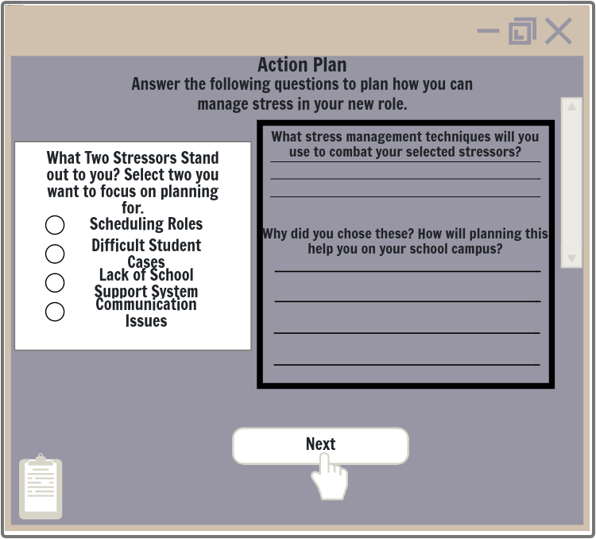
Slide ID: Action Plan 1.1
Targeted Learning Objective: Terminal Objective; Main Objective 1.0
Lesson Title: How to Manage Stress in Case Management
Visual:
Action Plan/Final Assessment:
This will be sent post-training via Google Forms
The ideas and concepts of the Action Plan remain the same.
-Multiple Choice Question Box to select answers
-Write-In Reflection Box to type in answers.
-Clipboard Icon clickable to pull up Case Management Sheet
-Next Button moves learners to next part of Action Plan
Programming/Interactions
Reviewer Comments
Audio:[Plays Automatically] Thank you for completing each scenario with us! We hope this gave you a chance to consider common stressors on school campuses and realistic ways to combat the stress. This final part of the training is critical to your time as a case manager. Given all that you have seen today, you will now create your own simple stress management plan to use on your campus. This plan is unique to you and your campus needs. Please use the question prompts to select stressors that you feel will be most likely to impact you. After selecting 2 stressors, you will plan stress management techniques that you will use while on campus. You will be prompted to consider when and how you would use these techniques.
Visual Notes: [Decision-Based Slide]: Learners will be prompted to select the types of stressors they want to plan for and the techniques they want to plan. Learners will then type in how they will use the selected stress management techniques and how this may benefit their role on their campuses. Both types of question boxes should be large. Page should start with multiple choice question box and then have type-in question box under the multiple-choice box.
Engagement: Knowles’ Principles of Relevancy, Autonomy, and Action/Reflection: Learners will be able to plan for stressors that are most relevant to them. Learners will be able to create their own stress management plan that best fits their needs and environment.

Slide 23
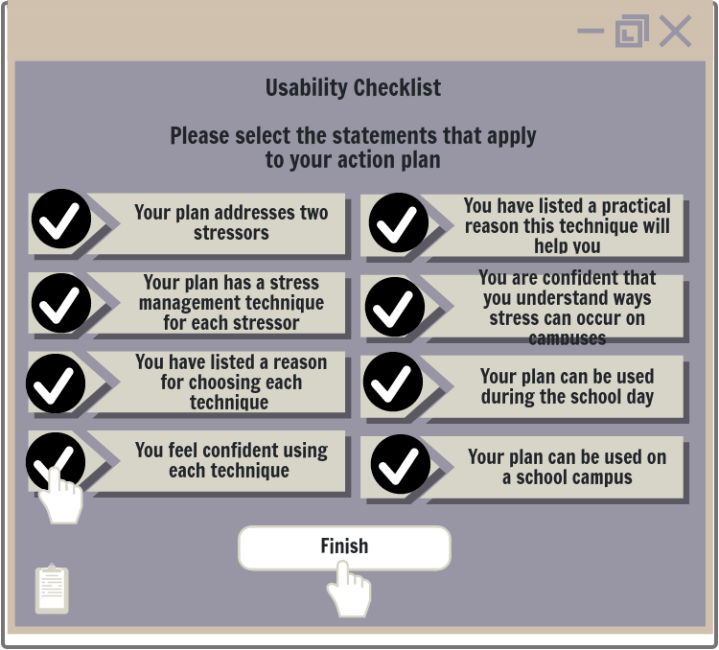
Slide ID: Action Plan 1.2
Targeted Learning Objective: Terminal Objective; Main Objective 1.1
Lesson Title: How to Manage Stress in Case Management
Learner Self-Check:
This will be sent post-training via Google Forms
The ideas and concepts of the checklist remain the same
-Learners will be prompted with self-check list on the side of the screen.
-Learners will review their plan ideas and check off each item that is in their plan.
-Clipboard Icon clickable to pull up Case Management Sheet
-Submit button will submit the action plan and send a copy to the learner.
Visual:
Programming/Interactions
Reviewer Comments
Audio: [Plays Automatically] Thank you for completing your action plan! The final step is to check your plan using a Usability Checklist on the right side of the screen. Simply read each part of the checklist and select if your plan includes the information. This can help you to evaluate if your current plan can be easily used on your school campus. You may still make changes to your action plan as needed.
Visual Notes: [Decision-Based Slide]: Learners will click on Checklist answers that apply to their Action Plan. Change from image: Learners will be able to view their action plan answers while using the Checklist. Action plan will be on left side of screen and Checklist on right side of screen. When finished completing the Checklist, learners will be sent to a End of Training Slide.
Engagement: Knowles’ Principles of Autonomy and Action/Reflection: Learners can check the relevancy of their own work to give learners control of their own learning.

Slide 24
Reference
Slade, T. (2020). The eLearning designer's handbook: A practical guide to the eLearning development process for new eLearning designers (2nd ed.).

Slide 25
Appendix
Stress Management Sheet Visual 1

Slide 26
Appendix Continued
Stress Management Sheet Visual 2

